Slide 1
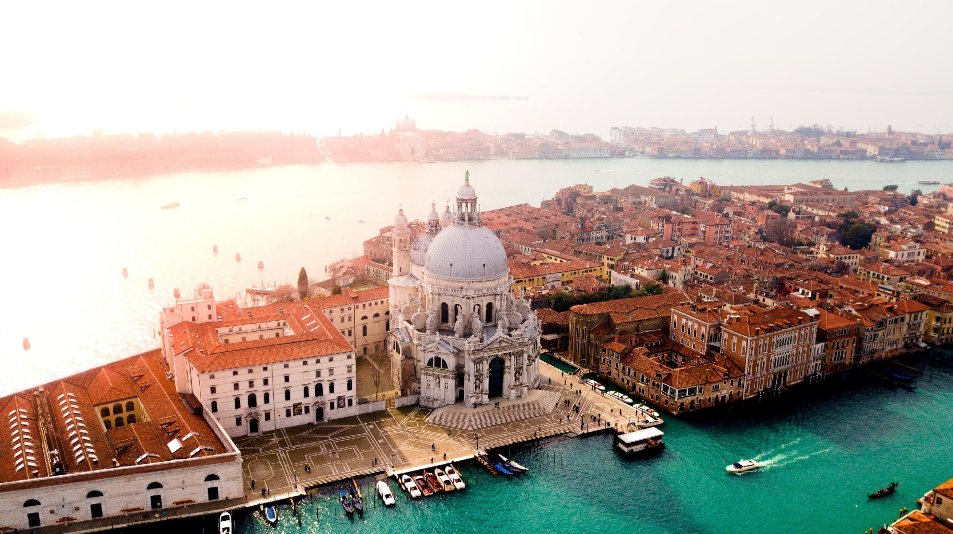
Venice: The Sinking City
The City of Canals is facing many challenges that is threatening the future of the inhabitants and its culture
Created by ESL Debates © 2020

Slide 2
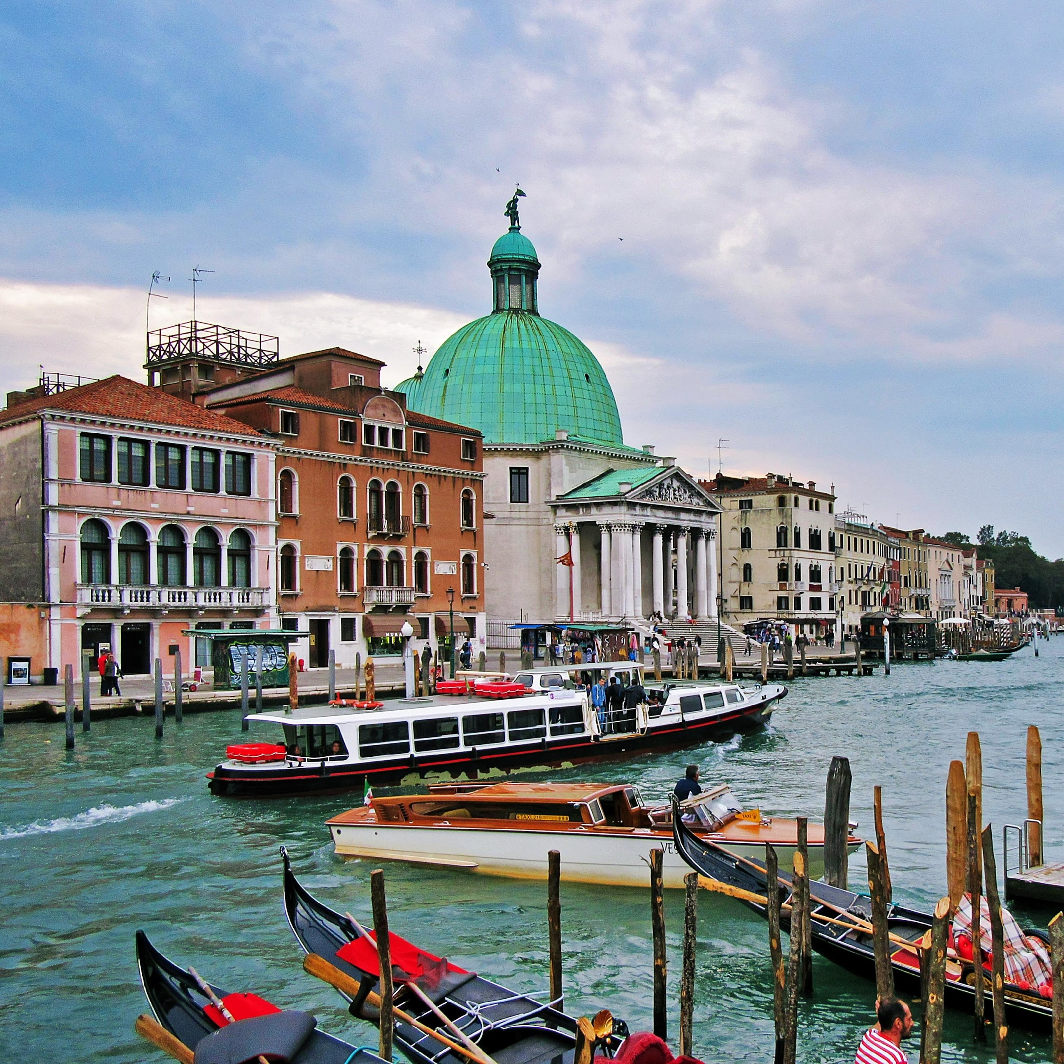
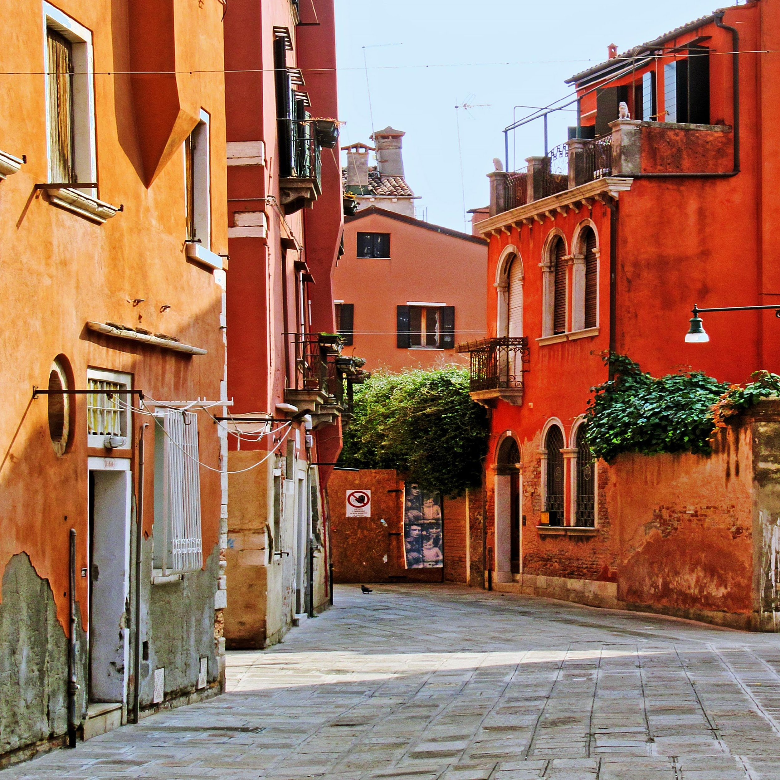
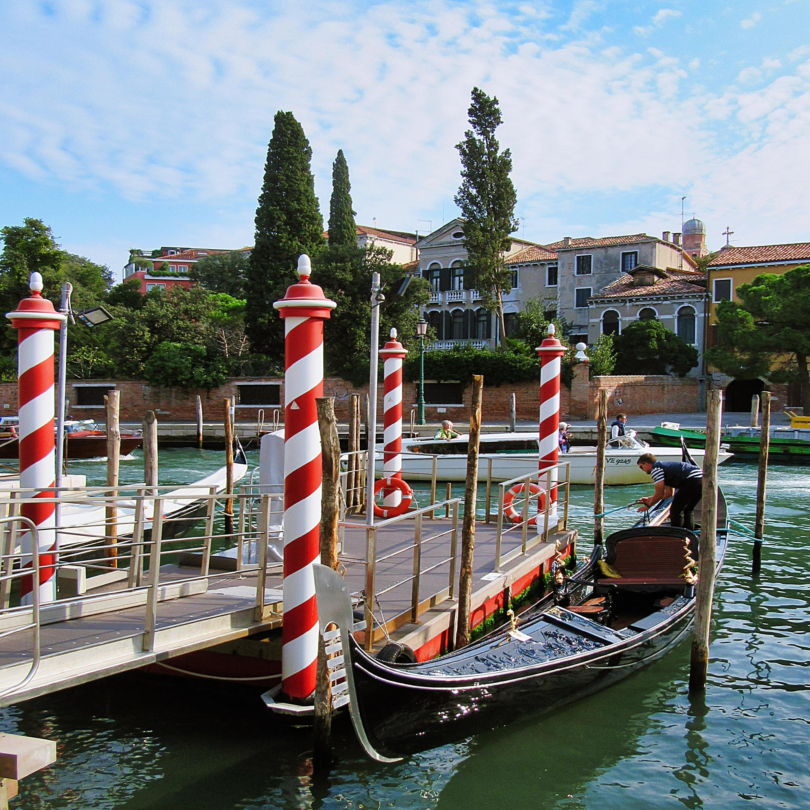
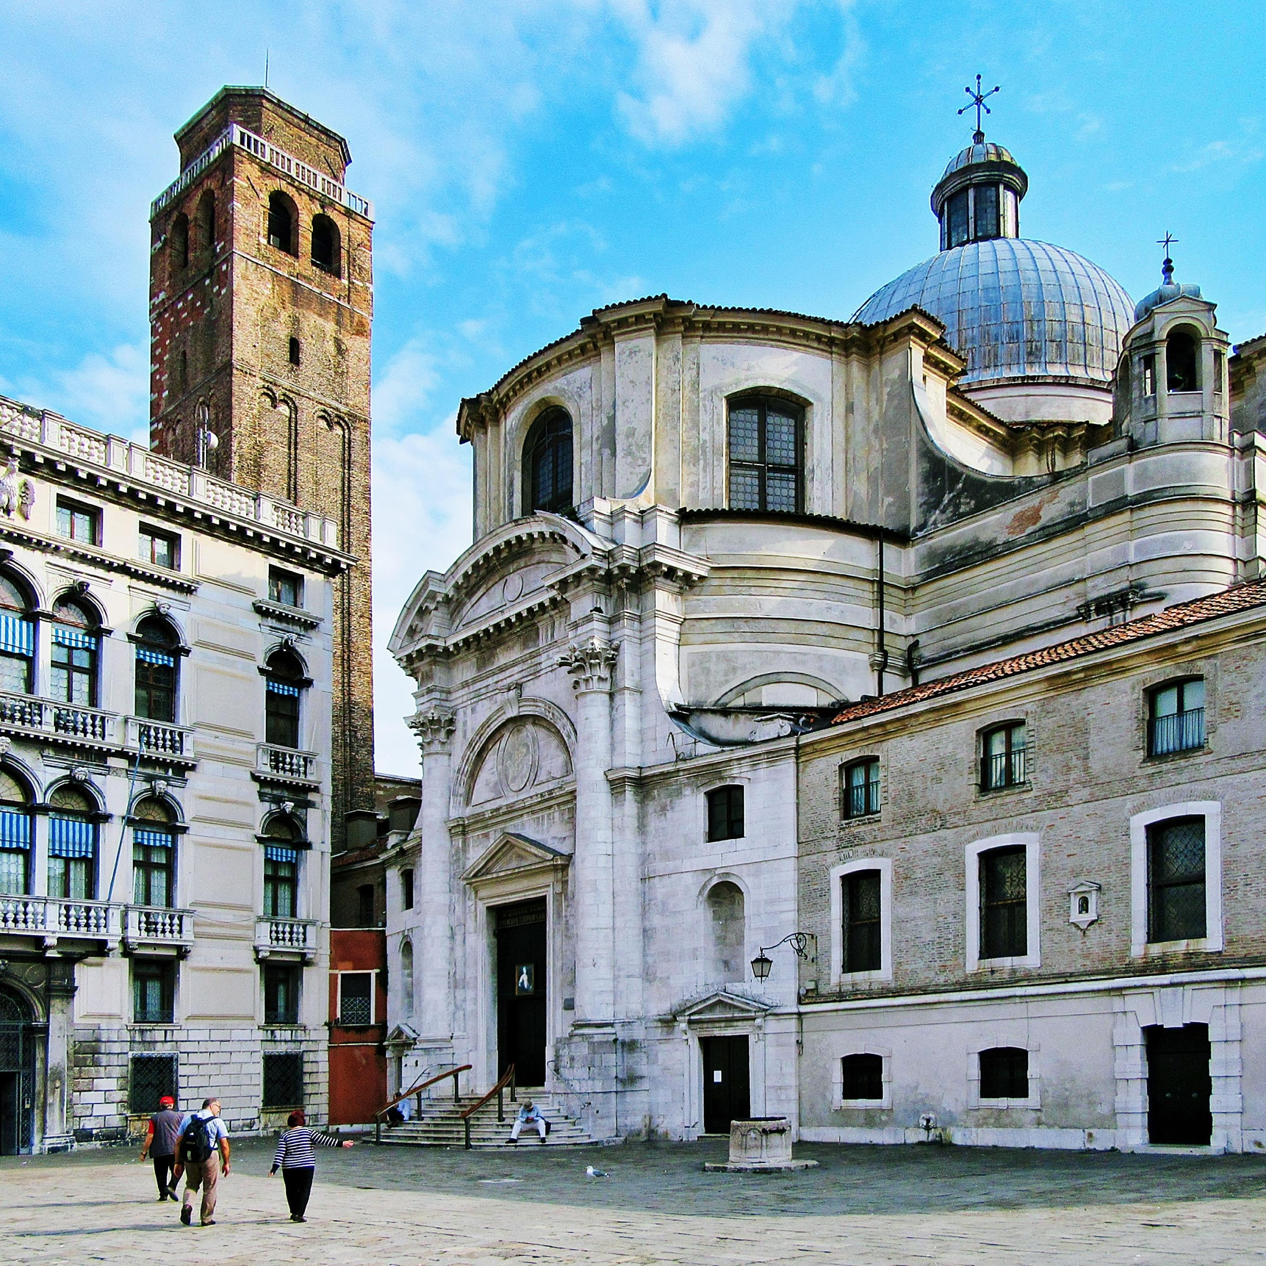
Discussion questions
When was the last time you went on holiday? Did you feel that there were too many people where you went?
If a holiday spot becomes every popular, what are the negative consequences for the locals?
Some areas in the world now ask for a 'tourism tax' which is paid by tourists at hotels. The idea is the use the tax money to invest in infrastructure and to help those areas. How do you feel about this tax?
Why have some places in the world become so incredibly popular that they now have too many tourists? What could create this situation?
If you were the mayor of Venice, what policies would you introduce to ensure the local people are looked after and the local culture is preserved?
Created by ESL Debates © 2020

Slide 3
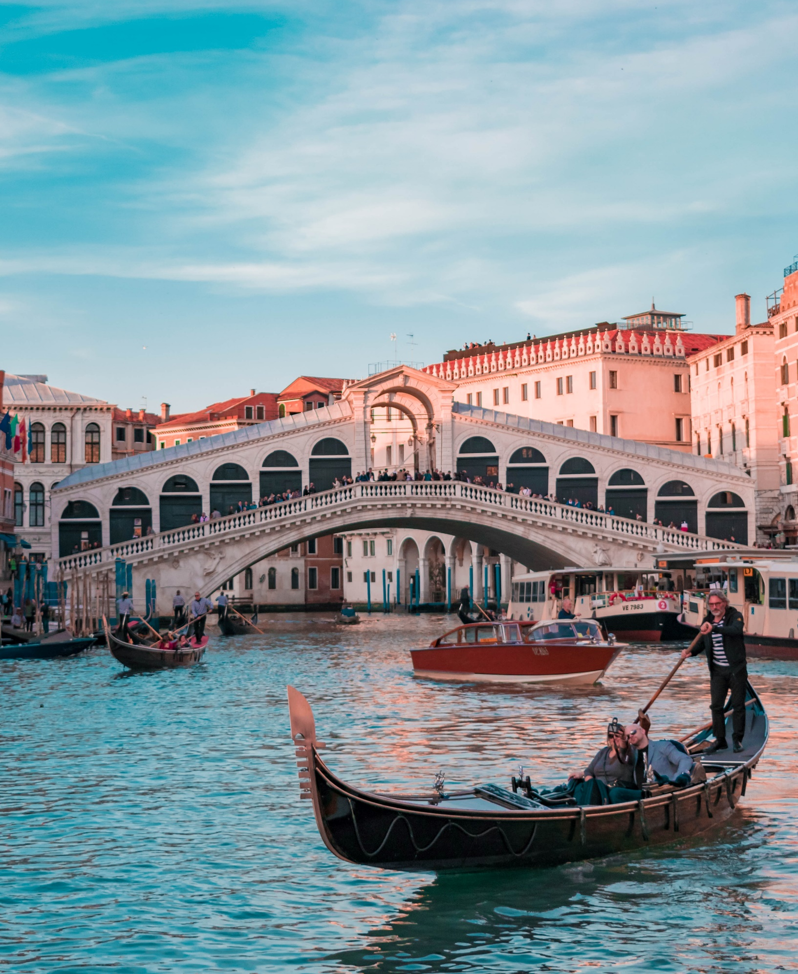
Debating motions
This house believes there is a difference between a traveller and a tourist.
This house believes that some areas in the world should have a tourism tax.
This house believes that tourism is quickly making cities into a giant theme parks and unliveable for locals.
Created by ESL Debates © 2020

Slide 4
Grammar task 1/2
With the city’s future already uncertain another unstoppable force is/are heading its way. Each year the Adriatic sea which feeds the lagoon surrounding Venice has been risen/rising at a rate of 2mm each year. When subsidence and water levels are combined/combining the once “floating city” is in fact sinking at roughly 4mm each year.
The rising tides also creates growing problems with the city’s canals, which flood four to five times each year, has earned/earning the name Acqua alta, or “high water”. During these times, residents need to place long planks of wood on pavements to stay/staying above the floodwaters.
If these trends continue, without any intervention from mean/meaningful engineering projects, the city could sink as much as 80mm within the next two decades.
In an effort save/saving the city, the Italian government has invested in a multibillion-euro project to installing/install flood-protection walls to block rising tides. Named the MOSE Project (Modulo Sperimentale Elettromeccanico) which consists/consisted of massive hollow metal blocks which can be raised and lowered/lowering according to the tide levels.
Created by ESL Debates © 2020

Slide 5
Grammar task 2/2
When in use, four defence barriers work together to raise air filled/been filled metal blocks that are anchored at one end to the sea floor. The barrier can be fully operational within 30 minutes.
According to La Stampa, the flood barrier, which was 85% complete in 2013, is already suffering from erosion/eroded caused by mould, and surprisingly, mussels. Some metal box sections that be/are waiting to be installed have been sitting on land for so long, that the sea air had/has started to rust them. Around 66 to 69 per cent of 156 hinges, which connect the metal box section to sunken concrete structures, are already say/said/saying to be unusable.
There has also been serious episodes of corruption and bribery to cover along/up work and plans that were bad in design and execution. To fix these design errors, an additional €700 million will be required. This is on/at top of the estimated €110 million maintenance cost and the initial €5.5 billion to create the project.
Created by ESL Debates © 2020

