Slide 1
Wooden skyscrapers could be the future for cities
Created by ESLDebates.com, Copyright 2020

Slide 2
“When Boston talks about carbon neutrality in buildings, they only ever talk about operational energy. No one ever talks materials.”
— John Klein, architect and designer

Slide 3
WOODEN SKYSCRAPERS COULD BE THE FUTURE FOR CITIES
Cities are fast becoming the main abode for people around the world. Urbanisation is a key element
that is fuelling growth and creating environments for innovation. That said, cities are made with vast
quantities of steel and concrete, which are not environmentally friendly. What if a new resource
could be used to create these urban jungles - wood. It is strong and sustainable and so makes a
good alternative to traditional materials. Whatever the benefits are, it is an untested material and
the immediate benefits could be misleading. Sustainable forestry will need water and land will be
covered in a monoculture of trees, hardly an environmentally-friendly solution.
This lesson explores the complexity of moving towards a sustainable construction material.

Slide 4
Discussion Questions
Because key words are great for catching your audience’s attention

Slide 5
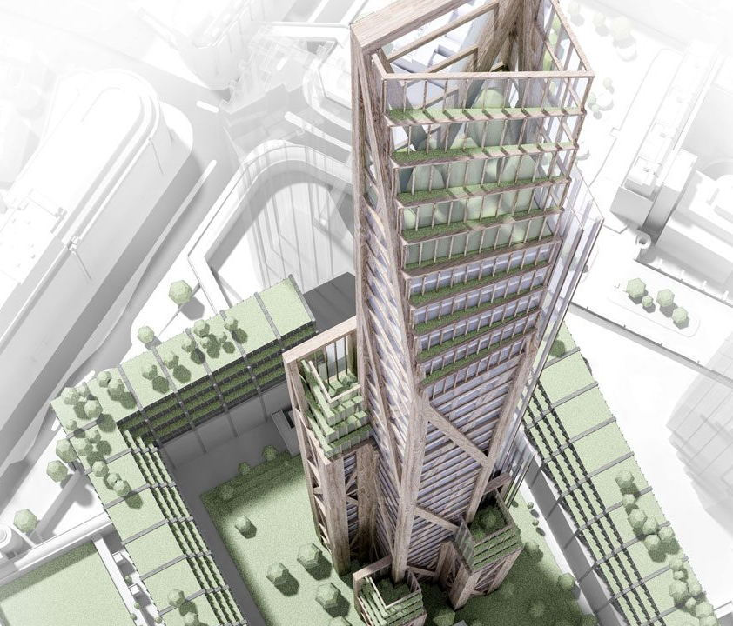
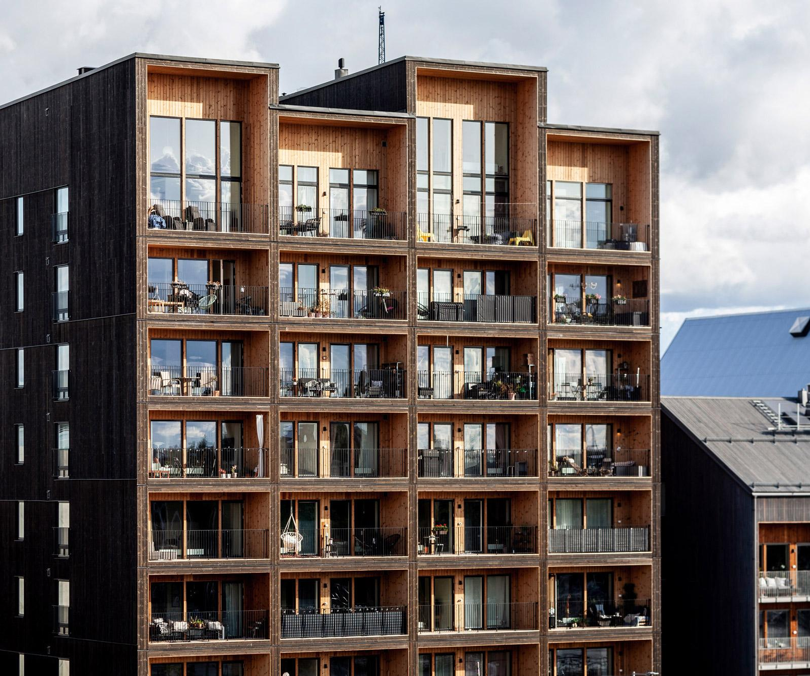
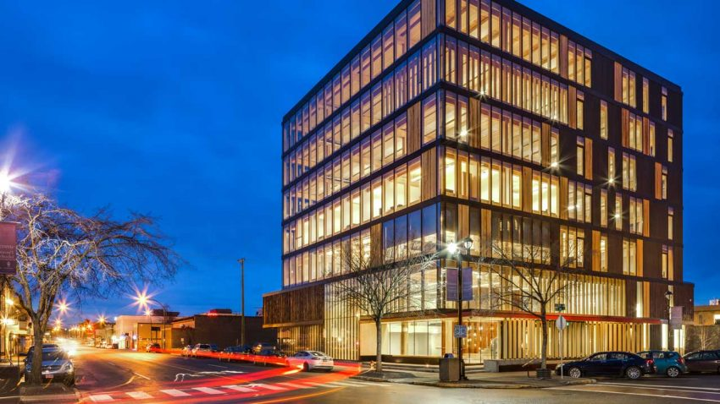
Discussion Questions
Q1.
Q2.
What ways can you think of that can improve the environmental friendliness of a building?
Of all materials used in a typical building, what will last the longest before needing to be replaced?
Q3.
Q4.
Q5.
Do you feel that your city is built using sustainable materials? Can you name any buildings that are?
Between wood and steel, what material can be recycled almost entirely?
What three things can be improved to the building you are in right now to improve its sustainability for the long-term?

Slide 6
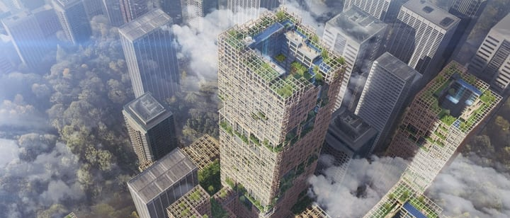
Discussion Questions
Q6.
Q8.
Environmentally speaking, how much carbon goes up in producing 1 tonne of steel and how much carbon is absorbed by 1 cubic metre of pine?
You can use external resources to help you discuss this question.
If all buildings are made from wood, usually pine, it would mean that large parts of the countryside will be planted by a monoculture of trees.
Does this sound like a
sustainable solution?
Q7.
Chile has 1.3 million hectares of radiata pine plantations, out of an approximate world total of 3.7 million hectares, which represents 35%. Then, how is it possible that Santiago ranks as one of the most polluted cities in the world frequently confronting air-quality alerts and pollution emergencies?

Slide 7
Article
Because key words are great for catching your audience’s attention

Slide 8
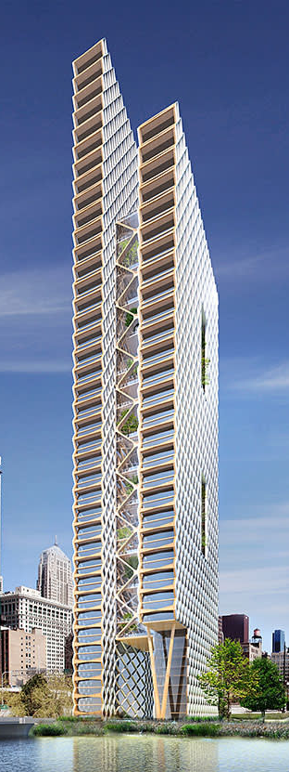
Wooden Skyscrapers could be the future for cities 1/4
Wood is, undoubtedly, the most prevalent construction material for building houses. Wood is an organic, hygroscopic and anisotropic material. Its aesthetic, electrical, acoustic, thermal, mechanical and working properties make it very suitable to use, as it is possible to build a comfortable house using only wooden products. Wooden buildings are becoming increasingly taller and more extensive due to the possibilities inherent in the original raw material.
Key benefits of wood include that it is reasonably lightweight and, unlike steel, it is easy to cut. Particularly, cross-laminated timber (CLT) is easy to process and very stable across dimensions. CLT panels can prefabricated and then transported on to the building site. This means that rooms and semi-finished sections can be pieced together at the construction site, and so speed up building time.

Slide 9
Wooden Skyscrapers could be the future for cities 2/4
But wood has some disadvantages too. The drawbacks of wood construction include susceptibility to fire, water damage, decay, and termites. Concrete and steel structure can last up to 100 years given the right care. Some experts say that wood is also a less environmentally sustainable choice than green building materials, such as composite lumber or recycled steel.
Despite its shortcomings, several wooden skyscraper designs have been designed and built. The tallest is now the 18-story wooden dormitory Brock Commons at the University of British Columbia in Canada. Also, the “Trätoppen”, a 40-story residential building, has been proposed by architect Anders Berensson, to be built in Stockholm, Sweden

Slide 10
Wooden Skyscrapers could be the future for cities 3/4
Wooden skyscrapers are considered to be a quarter of the weight of an equivalent reinforced-concrete structure. And they also reduce the building carbon footprint by 60 to 75%. The tallest ever-built wooden non-building structure was the tower of Muhlacker radio transmitter in Germany (190 metres). By 2024, Japan’s Sumitomo Group hopes to use CLT to build a 70-storey wood skyscraper in Tokyo, the world’s riskiest city when it comes to earthquakes
The benefits of using wood, however, could be negated without proper forestry management. Years of intense wildfire and insect blight have constrained timber supplies, said John Innes dean of forestry at the University of British Columbia in Vancouver, prompting foresters to ask for regulatory exceptions to harvesting limits. That could harm Canada’s sustainable forestry reputation.

Slide 11
Wooden Skyscrapers could be the future for cities 4/4
“The truth is, there is no such thing as sustainable building. Everything we do in building includes taking a cost out of something,” said Michael Green, a Vancouver-based architect. Sustainable management will likely increase costs for forestry companies, builders and taxpayers, but for many in British Columbia, home to giants both past and future, those are costs worth paying.

Slide 12
Reading Task
Because key words are great for catching your audience’s attention

Slide 13
Reading Task Questions
Wood is used more in the construction of skyscrapers and not houses because it is stronger.
CLT panels are too large and heavy to be transported when used in prefabricated components.
Sumitomo Group, a Japanese company, were the first to invent technology to build wooden skyscrapers.
Using wood in building construction will mean forest sustainability will be more difficult to manage.
Forest fires and insect blight can damage buildings made of wood.
Using timber in building construction increases the carbon footprint by 60 to 70%.
Architect Anders Berensson designed and built the first wooden structure in Sweden.
Concrete and steel structure can last up to 100 years given the right care.
True / False / Not Given
True / False / Not Given
True / False / Not Given
True / False / Not Given
True / False / Not Given
True / False / Not Given
True / False / Not Given
True / False / Not Given

Slide 14
Reading Task Questions - ANSWERS
Wood is used more in the construction of skyscrapers and not houses because it is stronger.
CLT panels are too large and heavy to be transported when used in prefabricated components.
Sumitomo Group, a Japanese company, were the first to invent technology to build wooden skyscrapers.
Using wood in building construction will mean forest sustainability will be more difficult to manage.
Forest fires and insect blight can damage buildings made of wood.
Using timber in building construction increases the carbon footprint by 60 to 70%.
Architect Anders Berensson designed and built the first wooden structure in Sweden.
Concrete and steel structure can last up to 100 years given the right care.
True / False / Not Given
True / False / Not Given
True / False / Not Given
True / False / Not Given
True / False / Not Given
True / False / Not Given
True / False / Not Given
True / False / Not Given

Slide 15
Word Choice
Because key words are great for catching your audience’s attention

Slide 16
Word choice questions
Key benefits of wood ___________ that it is reasonably lightweight and, unlike steel, it is easy to cut.
Q1.
include / including / included
The drawbacks of wood construction include _______ to fire, water damage, decay, and termites
Q2.
susceptibility / suspect / susceptible
Wooden skyscrapers are considered to be a quarter of the weight of an __________ reinforced-concrete structure.
Q3.
equivalent / equally / equal

Slide 17
Word choice questions
The benefits of using wood, however, ______ negated without proper forestry management.
Q4.
might be / could be / must be
Years of _______ wildfire and insect blight have constrained timber supplies
Q5.
intensifying / intensely / intense
Sustainable _______ will likely increase costs for forestry companies, builders and taxpayers
Q6.
manager / management / managing

Slide 18
Word choice questions
The tallest ever-built wooden non-building structure ______ the tower of Muhlacker radio transmitter in Germany (190 metres)
Q7.
is / was / is going to be
Despite its shortcomings, several wooden skyscraper designs have been ________ and built.
Q8.
design / designing / designed
Wooden buildings are _________ increasingly taller and more extensive due to the possibilities inherent in the original raw material.
Q9.
become / being / becoming

Slide 19
Word Matching

Slide 20
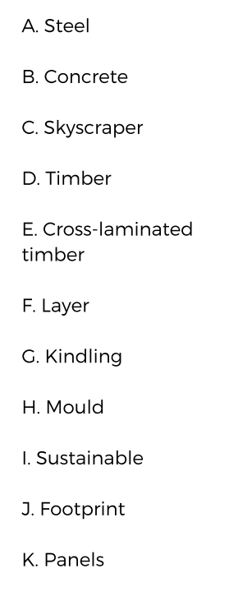
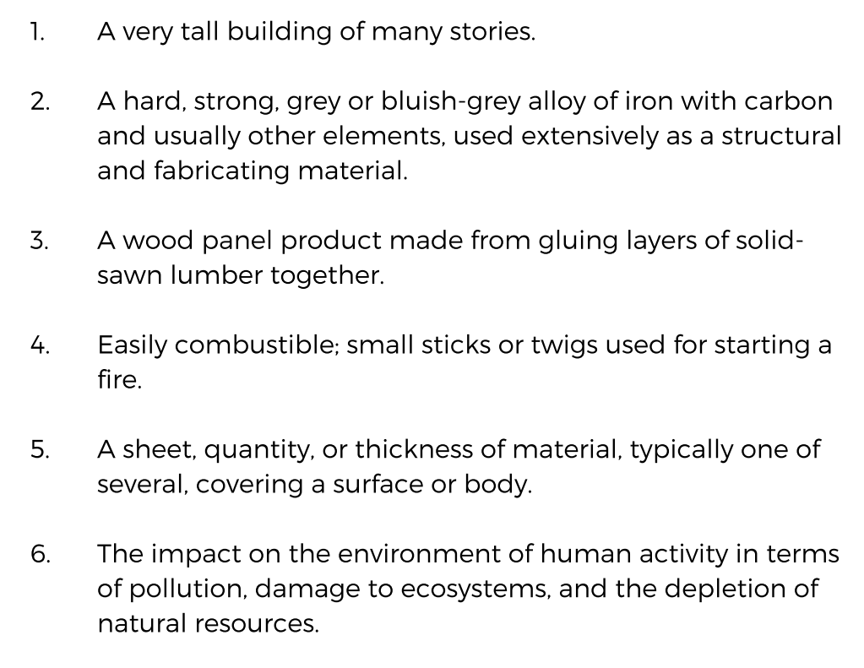
Skyscraper
Steel
Cross Laminated Timber
Kindling
Layer
Footprint

Slide 21
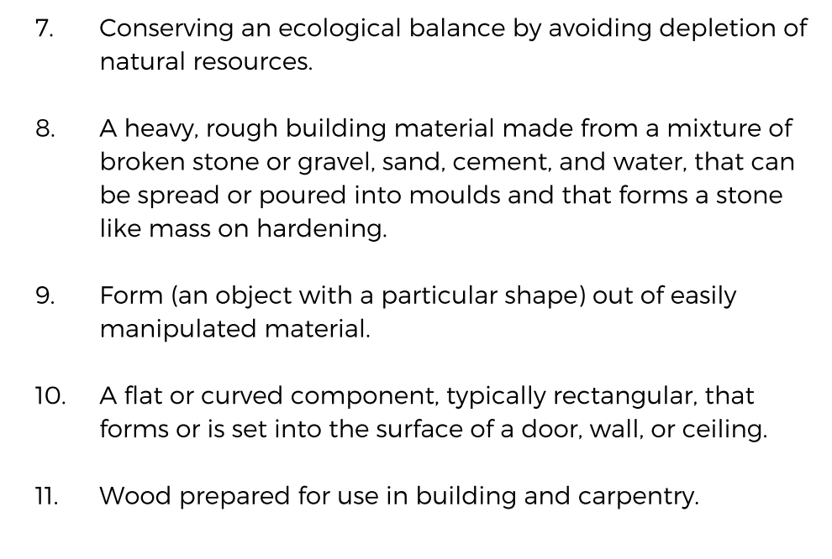
Sustainable
Concrete
Mould
Panel
Timber

Slide 22
Video Comprehension

Slide 23
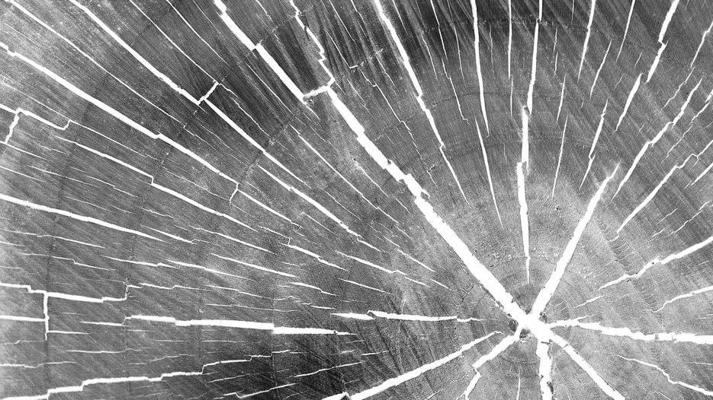
Video comprehension questions
Video Link: https://youtu.be/2DPp2NcnTb0
Mirror: https://www.esldebates.com/wooden-skyscrapers-could-be-the-future-for-cities/
1. What is High Rise’s perspective on steel and concrete?
2. What is wood’s major drawback?
3. When did the era of steelmaking commence?
4. Who is Michael Ramage?
5. Why are some architects proposing a return to wood?
6. What happens as trees grow?
7. What does a study say about using wood to construct a 125-skyscraper?
8. What is CLT?
9. What is CLT about?
10. But how does CLT cope when burnt with a high heat source?
11. Who is Andrew Waugh?
12. What has been Waugh’s experience with CLT?

Slide 24
Video comprehension questions - Answers
Video Link: https://youtu.be/2DPp2NcnTb0
Mirror: https://www.esldebates.com/wooden-skyscrapers-could-be-the-future-for-cities/
1. High Rise’s view is that all buildings should be made of timber; they think that we should be looking at concrete and steel like we look at petrol and diesel.
2. Throughout history, buildings have been made of wood but it has one major drawback. It acts as kindling. Fire has destroyed large swathes of some of the world's great cities.
3. By the early 20th century, the era of modern steel making had arrived. Steel was strong could be moulded into any shape and used to reinforce concrete.
4. He works at the Centre for Natural Material Innovation at the Cambridge University.
5. Concrete and steel are costly to produce and are heavy to transport. Wood, however, can be grown sustainably and it is lighter than concrete
6. As trees grow, they absorb carbon dioxide from the air, locking it into the timber.

Slide 25
Video comprehension questions - Answers
Video Link: https://youtu.be/2DPp2NcnTb0
Mirror: https://www.esldebates.com/wooden-skyscrapers-could-be-the-future-for-cities/
7. One study showed that using wood to construct a 125-metre skyscraper could reduce the building's carbon footprint by up to 75 per cent.
8. It is the short for cross-laminated timber. Regular timber is not malleable like steel or concrete and isn't strong enough to build high. But engineers have come up with the solution: CLT.
9. It is basically a new material, even though the underlying material is something we have used for millennia. It is cross-laminated so the layers of wood are glued at 90 degrees to each other, and that makes for a very stable material. CLT is light and it is comparable in strength to concrete and steel.
10. When you remove the source of flame, the fire extinguishers itself. When steel gets hot, it gets a bit softer. Some steel roofs have collapsed in fires where wooden roofs have not.
11. He is Co-founder of Waugh Thistleton Architects.
12. Cross-laminated is a material that he works with a lot. Once the CLT panels arrive on site with, they build a floor a week, at least. This is incredibly fast; this is, maybe, twice asn fast as concrete.

Slide 26
Debate pros and cons

Slide 27
Benefits of wooden construction
1. Speed of construction. Timber frames are usually built in a matter of days and the frame can be erected before any damage from weather can occur.
2. More flexible design. Timber frames can be crafted into almost any shape and are perfect for an open plan style construction.
3. Green and eco-friendly. Most forested trees are re-planted after they are felled and this makes them a good green option. Wood is a perfect renewable resource providing a perfect eco-friendly construction-building solution.
4. Can be built in freezing temperatures. Timber frame constructions can be built regardless of temperature. This is probably why wood constructions are used in colder parts of the world. In Scotland, for instance, over 70% of today’s new builds are timber-framed.
5. One company can do it all. As a general rule, one company can handle the entire construction building process, so construction is a lot simpler and quicker.

Slide 28
Benefits of wooden construction
6. Building time. Because of the time it takes to build walls, plaster them, throw the concrete floors, and dry properly, brick and block frame buildings take longer to construct than timber frame buildings.
7. Thermal Properties. Many materials change in size and volume as the temperature changes. They expand with increasing of the temperature. Wood does not practically expand against heat. On the contrary, by the effect of heat, it dries out and gains strength.
8. Electrical Properties. Static electricity that is dangerous for human health is not observed in wood unlike metal, plastic and other materials. For this reason wood is preferred as a healthy material.
9. Aesthetic Properties. Wood is a decorative material; it is possible to find different wooden materials according to color and design preference.

Slide 29
Drawbacks of wooden construction
1. Fire. A timber frame building does not withstand the heat and flames in the same way a brick and mortar construction would. A timber-framed building can be treated with fire retardants, but this merely slows the surface spread of flames and reduces the production of smoke.
2. Energy efficiency and sound-proofing. Timber frame buildings are not as energy efficient as masonry buildings because they are packed with insulation. As far as sound-proofing goes, timber does not block out sounds as a solid brick construction does.
3. Damp conditions. Damp problems can occur when a timber frame building has been poorly built in an area where wet conditions dominate. A timber frame building will eventually rot if exposed to constant or long-term dampness wood.

Slide 30
Drawbacks of wooden construction
4. Condensation. If condensation builds up in a timber construction, it can cause damp problems that could ultimately rot the wooden skeleton of the building.
5. Shrinkage and Swelling. Wood is a hygroscopic material. This means that it will adsorb surrounding condensable vapors and lose moisture to air below the fiber saturation point.
6. Deterioration of Wood. Biotic (biological) and abiotic (non-biological) are the agents causing the deterioration and destruction of wood. Biotic agents include decay and mold fungi, bacteria and insects. Abiotic agents include sun, wind, water, certain chemicals and fire. a

Slide 31
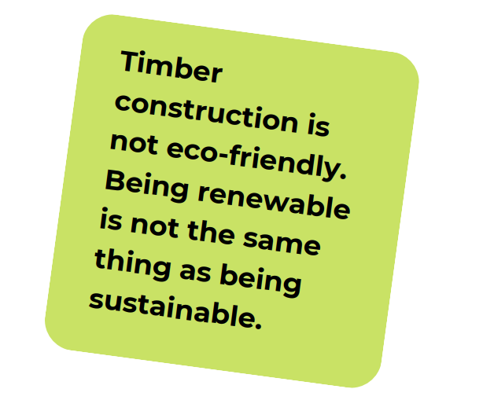
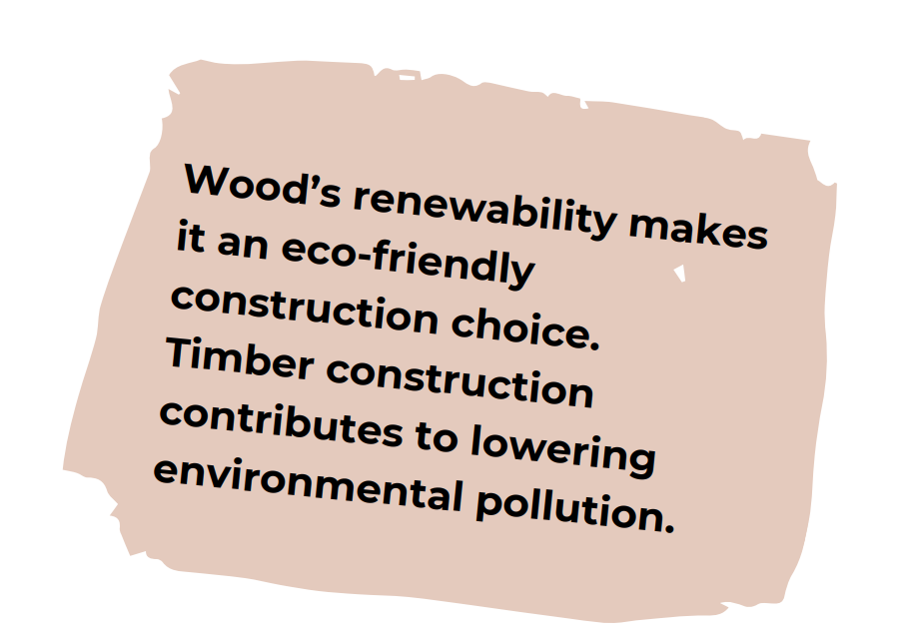
Debate topics

